Slide 1
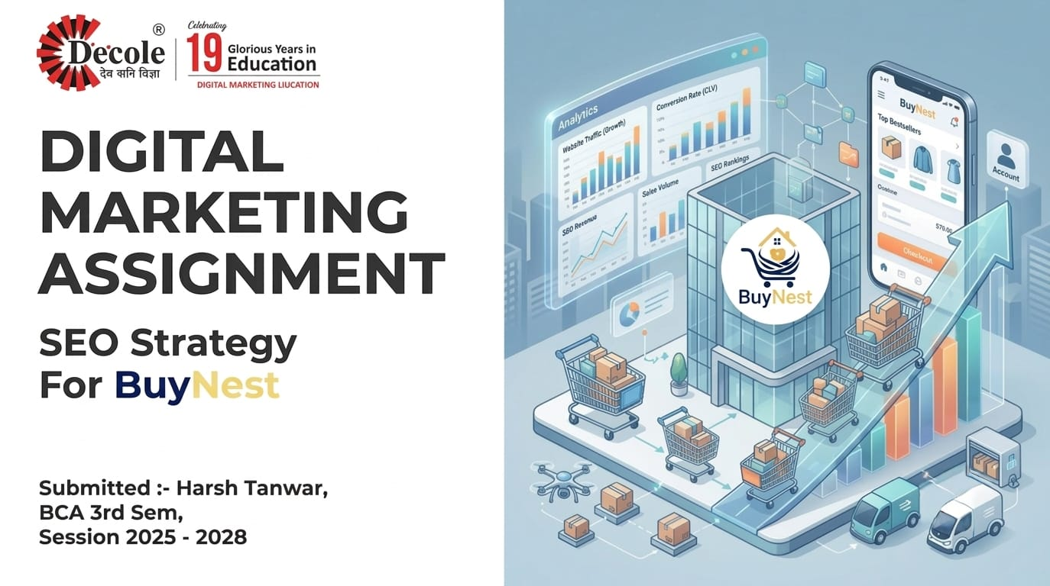

Slide 2

Digital Marketing
Assignment Report
--------------------------------------------------------------------------------------------------------------------------------------------------------------------------------
ASSIGNMENT FOLIO
Assignment Folio of
Digital Marketing
Submitted to
Dezyne École College
Toward Digital Marketing
By
BCA
3rd Semester
Harsh Tanwar
Dezyne École College
106/10, Civil Lines, Ajmer
www.dezyneecole.com
2026-2027
--------------------------------------------------------------------------------------------------------------------------------------------------------------------------------

Slide 3
Digital Marketing
Acknowledgement
--------------------------------------------------------------------------------------------------------------------------------------------------------------------------------
ASSIGNMENT FOLIO
We take this opportunity to express our sincere gratitude to Dezyne École College for providing us with the knowledge,
resources, and guidance essential to the successful completion of this project.
Our deepest thanks to our respected Principal, Dr. Vinita Mathur, for her visionary leadership and continuous encouragement.
Her commitment to academic excellence and student growth has been a constant source of motivation and pride.
We are equally thankful to all our faculty members for their consistent support, expert advice, and valuable insights that
shaped our learning and helped us achieve this milestone.
Lastly, we extend heartfelt thanks to everyone who directly or indirectly contributed to the success of this project.
We are proud to be part of Dezyne École College, an institution that truly nurtures professionalism, innovation, and purpose.
With sincere appreciation,
Harsh Tanwar
Department – BCA
Dezyne École College, Ajmer
--------------------------------------------------------------------------------------------------------------------------------------------------------------------------------

Slide 4
Digital Marketing
Case Study
--------------------------------------------------------------------------------------------------------------------------------------------------------------------------------
ASSIGNMENT FOLIO
SEO Optimization
Objective:
To improve the search engine visibility, organic traffic, and overall website performance of a newly launched website by implementing effective On-Page, Off-Page, and Technical SEO strategies.
1. Website & Keyword Planning
Analyzed the website structure and performed keyword research to identify primary, secondary, and long-tail keywords based on user search intent (informational, navigational, transactional).
2. On-Page SEO Implementation
Optimized web pages using SEO-friendly URLs, title tags, meta descriptions, and proper heading structure (H1 – H3) to improve relevance and search engine ranking.
3. Off-Page SEO Activities
Built high-quality backlinks through guest posting, business listings, profile creation, social bookmarking, and forum participation to increase domain authority
4. Technical SEO Optimization
Improved page speed, mobile responsiveness, and HTTPS security, to ensure better crawling and indexing.
--------------------------------------------------------------------------------------------------------------------------------------------------------------------------------

Slide 5
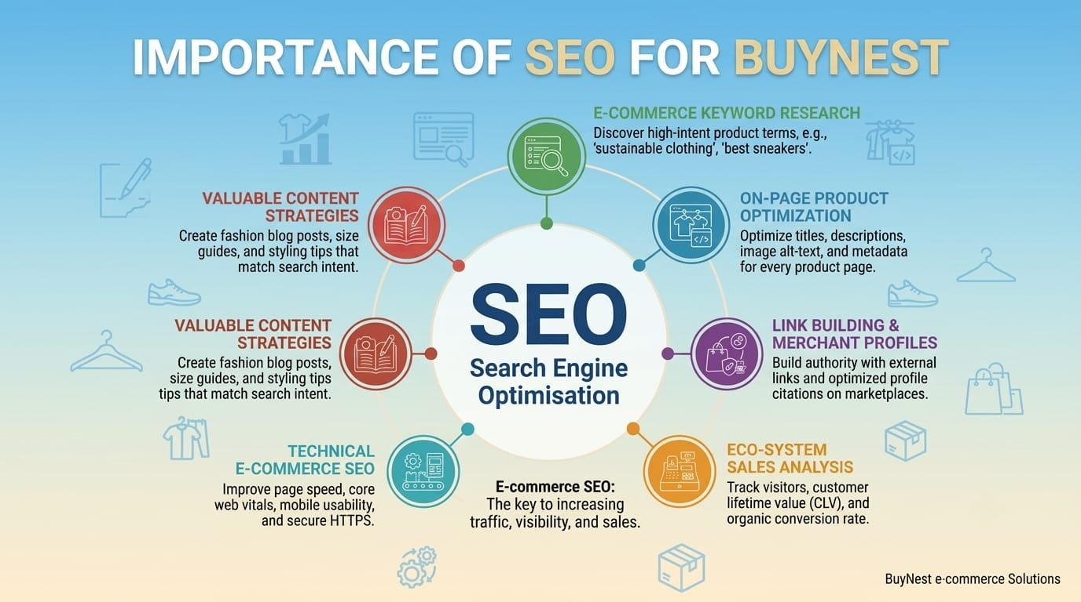

Slide 6
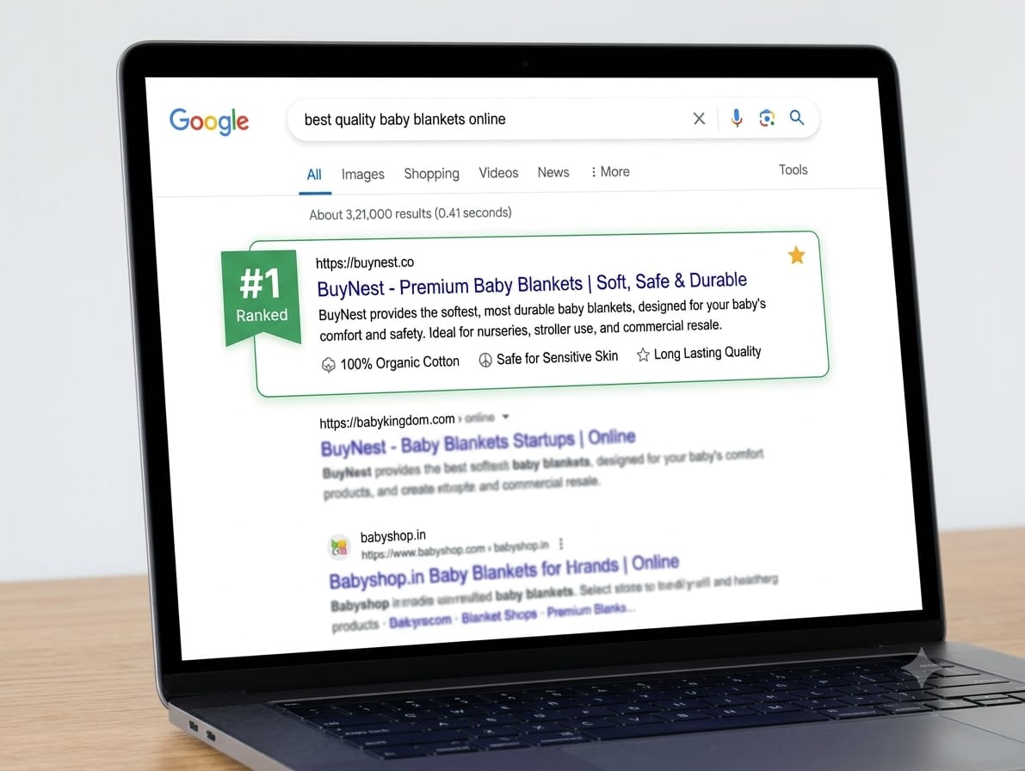
KEYWORD RESEARCH FRAMEWORK
PRIMARY KEYWORD ANALYSIS
Primary Keyword — Short-tail
"buy electronics online"
Intent: Transactional / Commercial Purchase — Users ready to complete a purchase immediately.
Secondary Keyword — Long-tail
"best budget wireless earbuds under 2000 in India"
Intent: Commercial Investigation / Buyer Research — Users comparing options before purchasing.

Slide 7
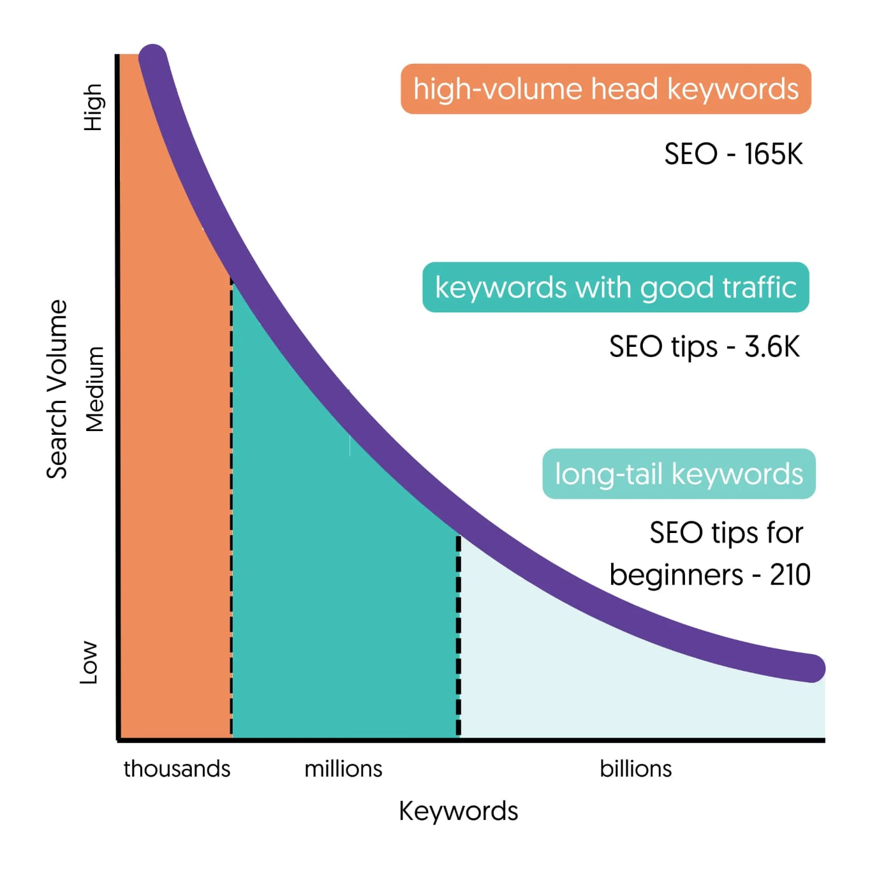
LONG-TAIL KEYWORD TARGETING
buy women clothes online India
oversized t shirts for men online
best fashion clothes under 999
women's party wear dresses for wedding
men's office wear outfits online

Slide 8

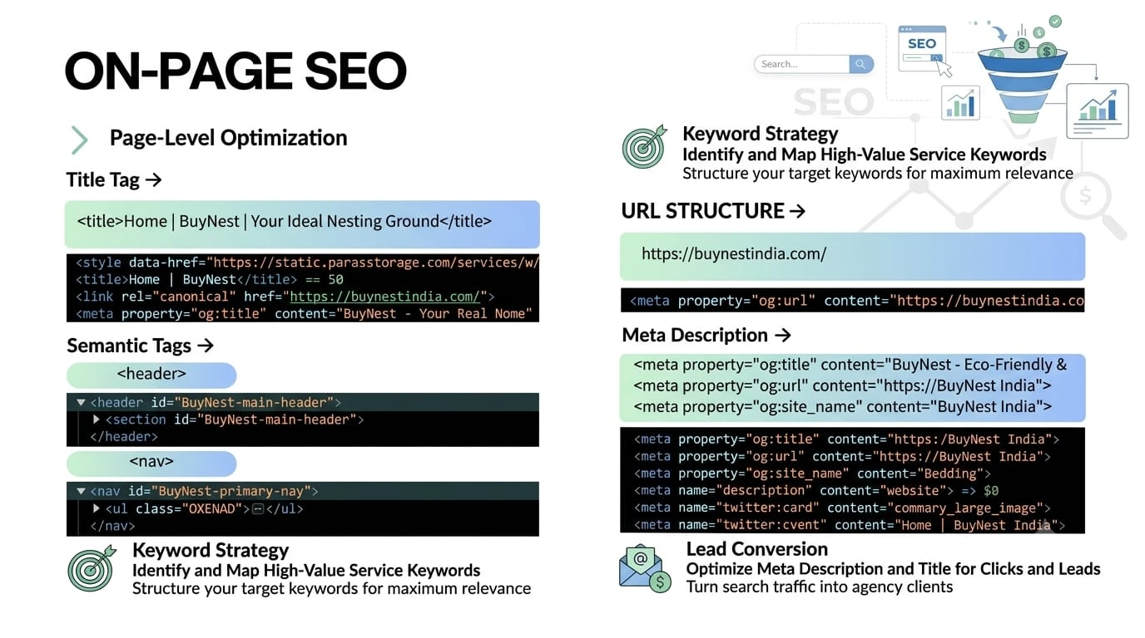
On-Page SEO Implementation Strategy
SEO-Friendly URL
Meta Title
Meta Description
https://dev-yourwebsites.pantheonsite.io
Buy Best Wireless Earbuds Online at Lowest Prices | BuyNest India
Shop top-rated noise-canceling wireless earbuds on BuyNest. Enjoy mega discounts, fast pan-India delivery, and easy returns.
H1
H2
H3
Buy Wireless Earbuds & Bluetooth Earphones Online
Top Featured Earbud Models
Active Noise Cancellation (ANC) Modelsz

Slide 9
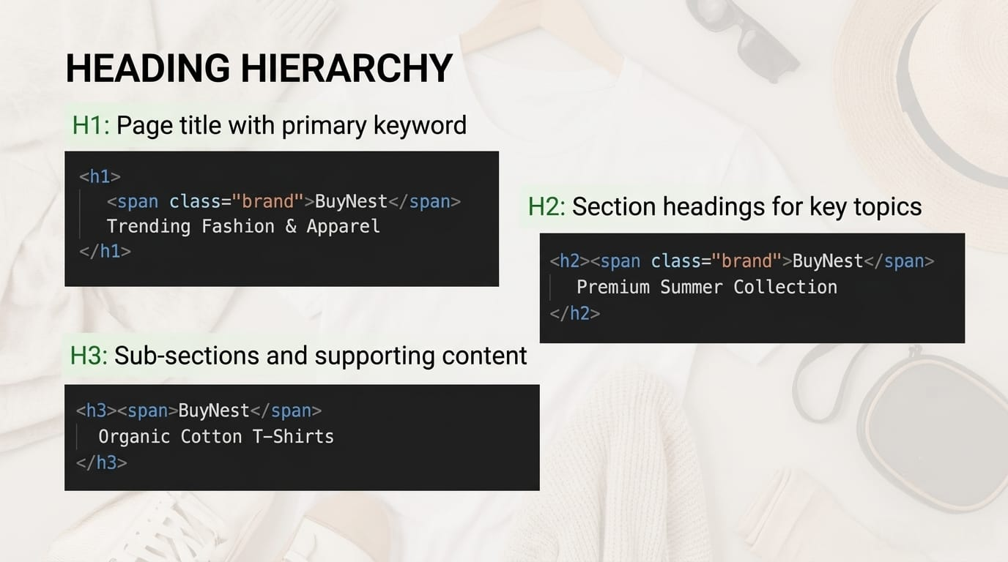

Slide 10
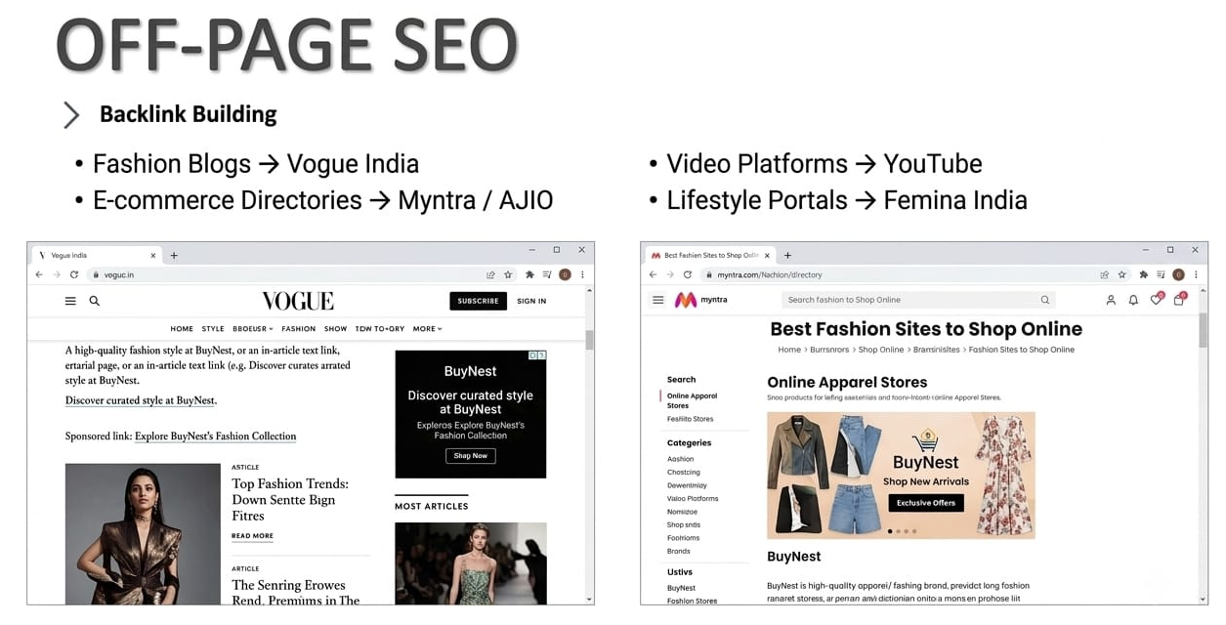
Referral Source Strategy

Slide 11
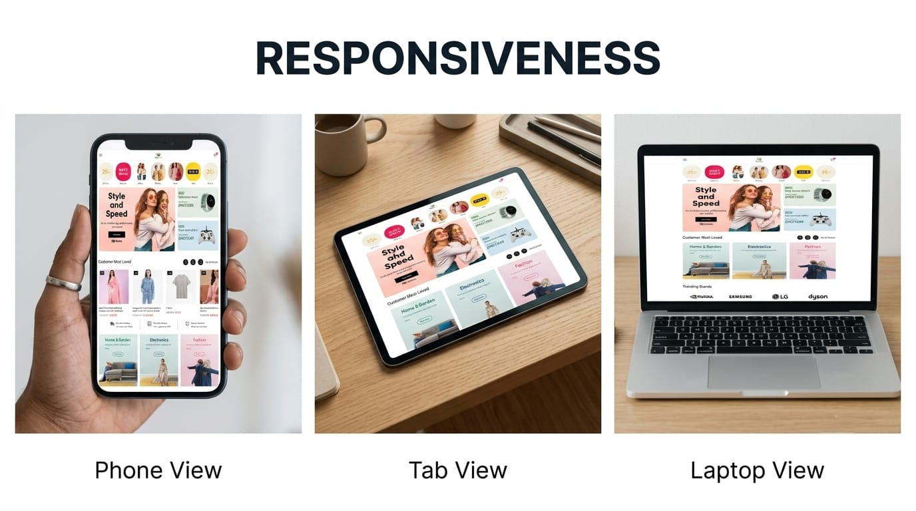

Slide 12
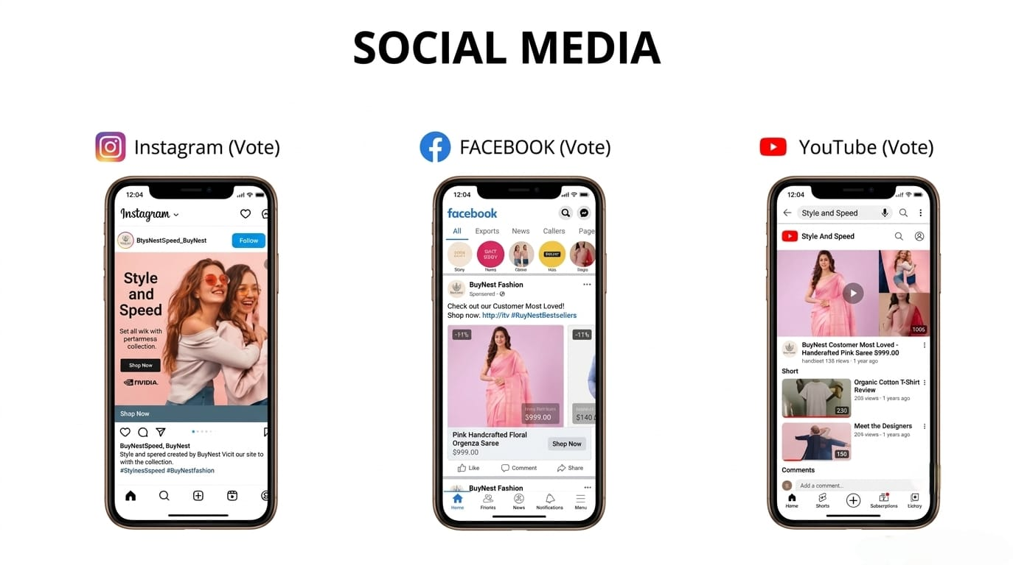

Slide 13

Technical SEO Optimization Framework
What is Technical SEO?
Technical SEO optimizes website backend infrastructure for efficient search engine crawling, indexing, and rendering.
XML Sitemap
Provides search crawlers a structured index of all active product and category URLs for accelerated indexing and discovery.
User-agent: *
Disallow: /checkout/
Disallow: /cart/
Disallow: /admin/
Allow: /products/
Allow: /category/
Sitemap: https://www.buynest.in/sitemap.xml
Crawl
Index
Rank

Slide 14
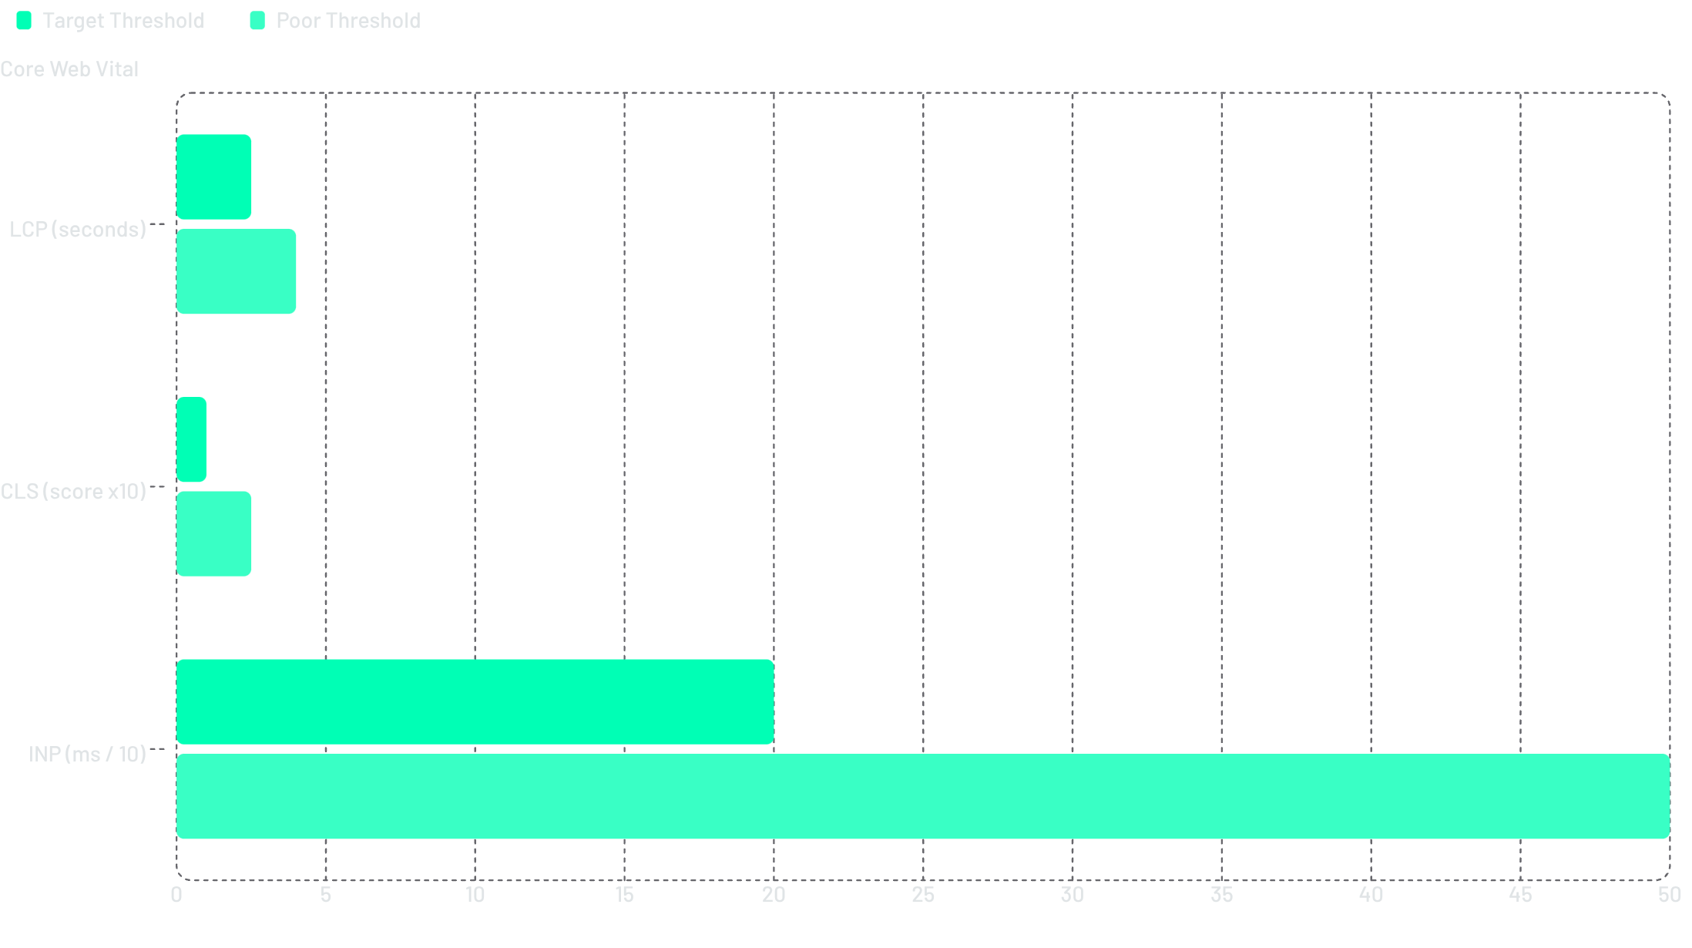
Core Web Vitals & Page Speed Metrics
<2.5s
<0.1
INP
LCP Target
CLS Score
Interaction Speed
Largest Contentful Paint — Main product images must load within 2.5 seconds to maintain user engagement and reduce bounce rate.
Cumulative Layout Shift — Score below 0.1 prevents unexpected layout shifts during ad loads and dynamic content rendering.
Interaction to Next Paint — Optimized JavaScript execution ensures instant click responses and frictionless navigation.

Slide 15
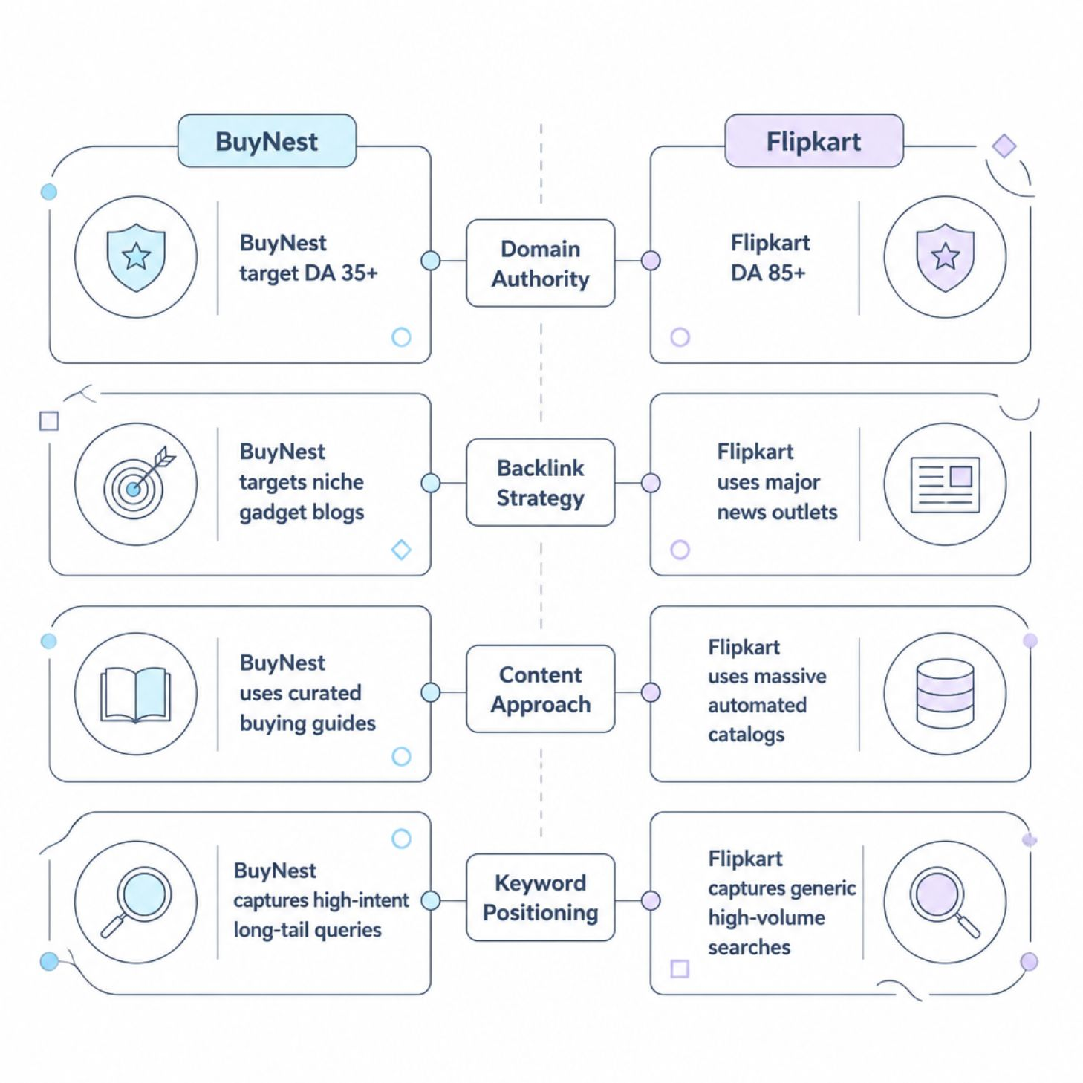
Competitor Analysis: BuyNest vs. Flipkart
Key Differentiators
While Flipkart dominates on sheer scale and domain authority, BuyNest's competitive advantage lies in precision targeting and content quality.
DA Gap: Flipkart 85+ vs. BuyNest target 35+
Backlinks: News outlets vs. niche gadget blogs
Content: Automated catalogs vs. curated guides
Keywords: Generic volume vs. high-intent long-tail
BuyNest's long-tail keyword strategy targets buyers closer to the point of purchase — yielding higher conversion rates per visitor.

Slide 16




Three Key Improvement Recommendations
1
2
E-commerce Schema Markup
Interactive Buying Guide Hub
Implement JSON-LD structured data for product price, stock status, and review ratings to enable Google Rich Snippets and enhance SERP visibility.
Publish curated blog content (e.g., "Top 10 Laptops for Students") to capture informational search queries and build topical authority.
3
Mobile Core Web Vitals Optimization
Improve Largest Contentful Paint (LCP) and interaction speed for a seamless mobile checkout experience across all device categories.

Slide 17



Conclusion & Future Roadmap
Strategic Summary
Future Initiatives
Balanced execution of on-page, off-page, and technical SEO enables BuyNest to build organic visibility, lower acquisition costs, and compete effectively against Flipkart.
Continuous content expansion, voice search optimization, and aggressive backlink acquisition from high-authority Indian e-commerce and tech publications.
Closing Statement
Thank you for your time and attention. This presentation is open for questions and academic discussion.
HARSH TANWAR | BCA | DEPT. OF COMPUTER APPLICATIONS | +91 8209357455

Slide 18


